Slide 1

Basic Excel functions for Data analysis

Slide 2

Know the excel !!!
Welcome to the journey of mastering Excel! Excel is such a powerful tool for data analysis, organizing information, and performing calculations. This presentation will explore essential functions that will help your data analysis skills and insights. Let’s ready to learn more about Excel !!!

Slide 3

Microsoft Excel
★ Microsoft Excel, developed by Microsoft corporation, is a spreadsheet program that allows us to store, organize, and analyze information.
★ Excel has added features like pivot tables, data analysis tools, and collaboration options, becoming a vital tool in business and academia.
★ Excel is widely used for various tasks, from simple data entry to complex financial Modeling.

Slide 4

Basic Excel Functions
Spreadsheet Layout: Understand the grid of rows (numbers) and columns (letters).
Basic Operations: Learn to enter and format data (numbers, text, and dates).
Basic Formulas:
=SUM(A1:A5): Adds values.
=AVERAGE(A1:A5): Calculates the average.
=COUNT(A1:A5): Counts numbers.
=IF(condition, value_if_true, value_if_false): Simple logic statements.
Cell Referencing: Absolute ($A$1), Relative (A1), and Mixed ($A1 or A$1) references.

Slide 5

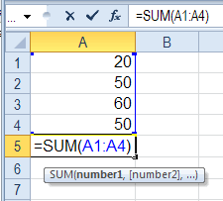
SUM Function
The SUM function in Excel adds together a range of numbers
SUM=SUM[(Number 1),(Number 2 ),…]
where you can input individual numbers, cell references, or ranges
Here is an example,
=SUM(A1:A4) Adds all value from cells A1 to A4

Slide 6

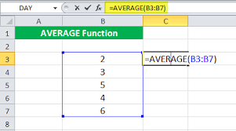
AVERAGE Function
The AVERAGE function in Excel is a powerful tool for calculating the average of a range of numeric values.
Syntax: =AVERAGE(number1, [number2], ...)
Example: To find the average of values in cells B3,B4,,,,&B7,enter =AVERAGE (B3:B7)

Slide 7

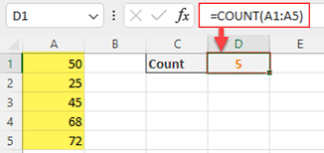
COUNT Function
The COUNT function in Excel is very useful for performing calculations related to counting the number of cells in a range that contains numbers
It is particularly useful when you want to determine the quantity of numeric entries within a dataset.
Syntax: =COUNT(value1, [value2], ...)
Example: To count the number of numeric entries in cells A1, A2,…. & A5, enter =COUNT (A1:A5)

Slide 8

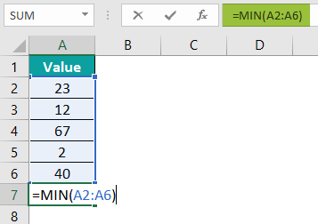
MIN Function
The MIN function in Excel are valuable tools for performing
calculations related to finding the minimum value within a range of cells.
These can be applicable in various scenarios, from analyzing test scores to financial data.
Syntax : = MIN(number1, [number2], ...)
Example1: To find the minimum value among cells A2, A3,…& A7, enter =MIN(A2:A6)

Slide 9

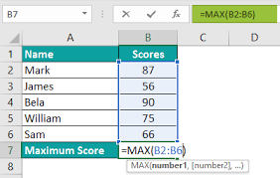
MAX Function
The MAX function in Excel are valuable tools for performing
calculations related to finding the maximum value within a range of cells.
These can be applicable in various scenarios, from analyzing test scores to financial data.
★ Syntax : = MAX(number1, [number2], ...)
Example1: To find the maximum value among cells B2, B3,…& B6, enter =MAX(B2:B6)

Slide 10

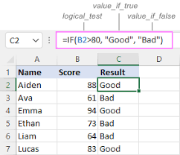
IF Function
The IF function in Excel is used to make logical comparisons between a value and what you expect.
It can return one value if the condition is true, and another value if it is false.
It creates conditional statements based on logical tests, allowing you to make decisions based on specified conditions, and thereby enabling you to create dynamic and flexible spreadsheets
Syntax: =IF(logical_test, value_if_true, value_if_false)

Slide 11

Conclusion
Excel functions are powerful tools that help users perform a wide range of calculations and data analysis. There are different functions are used in Excel for different purposes. Excel functions are powerful tools that help users perform a wide range of calculations and data analysis Exploring and applying these tools to enhance your skills and drive success in your projects

Slide 12

Thanks!
Any Queries?
ajaycraju98@gmail.com

